Slide 1
The Ambient Intelligence
Kongu Engineering College
Department of CSE
Divya R , Boomika S

Slide 2
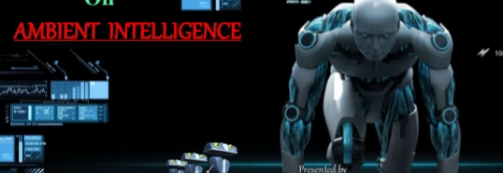

Synopsis
Introduction.
Some elements of an AMI environment.
Technologies.
Steps of Ambient Intelligence.
Application.
Research works.
Future scope.
Benefits of AMI.
conclusion.

Slide 3
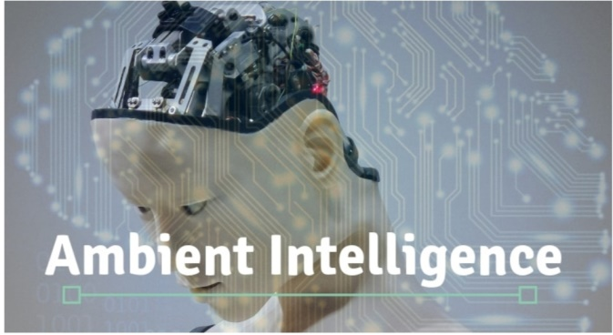
Introduction
intelligence to our every day environment and makes environments sensitive to us.
Network of hidden intelligent interfaces

Slide 4

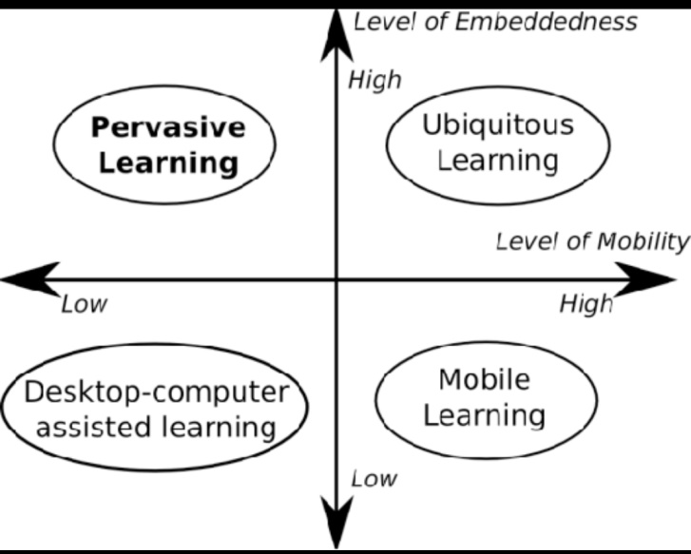
Some elements of an AMI environment:
1.Embeddedness.
2. transparency.
3. Context awareness.
4. Machine learning.

Slide 5
Technologies:
Ubiquitous computing and communication
Integration of microprocessors into everyday objects.
ad-hoc and wireless networking.

Slide 6
Intelligence user interface
Enables the AML environment inhabitants .

Slide 7
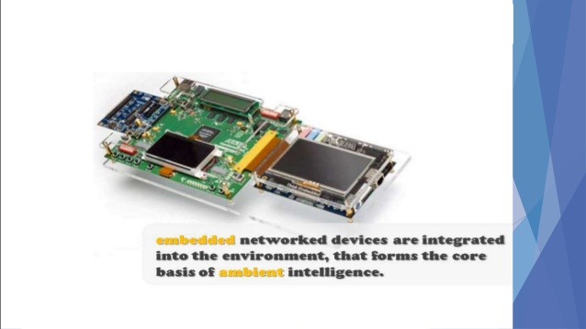
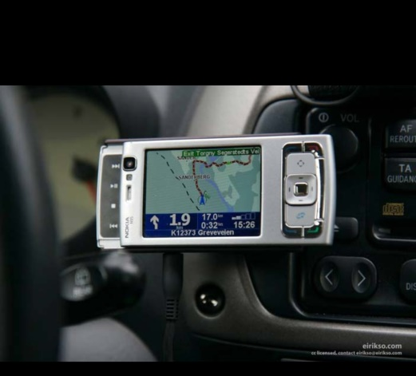
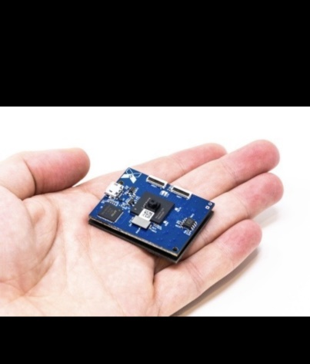
Technologies
Some other technologies:
->Bluetooth low energy
->RFID
->Sensors
->Software Agents
->Biometrics

Slide 8
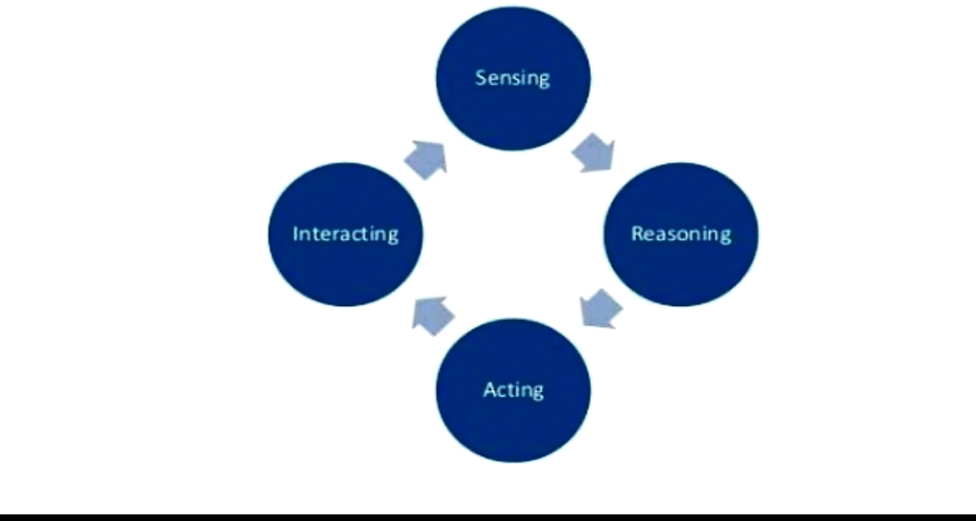
Steps of Ambient Intelligence
1.Sensing:
By using sensors and Ambient.
2.Reasoning:
->Needed to provide responsiveness and adaptability.
->interpret and recognize context and activity.
-> mobility tracking.
-> decision making.
3.Acting:
->home automation systems (lights, doors, room temperature.,)
->Robotics.
4.Intracting with users:

Slide 9
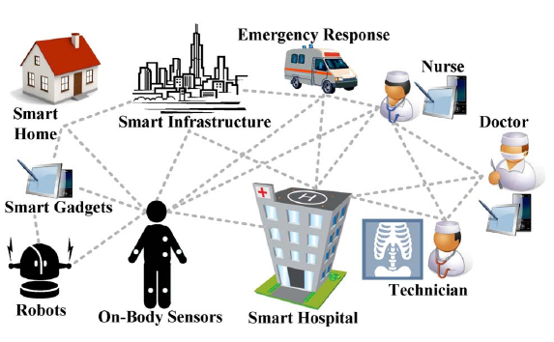
Applications:
->smart Homes
->Health-related Applications
->Emergency services
->Public transport sector
->Public surveillance
->health care sector

Slide 10
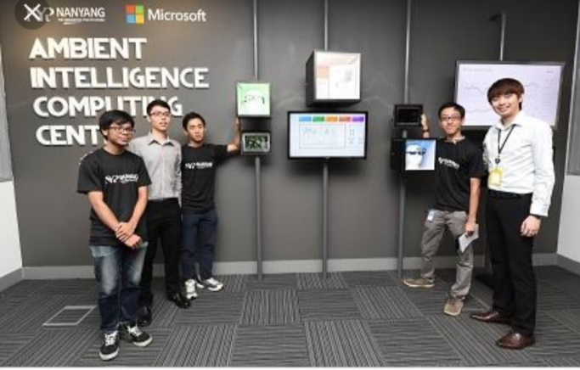

Internal Fridge Home OS Smart TVS Connected cars
Research Works:

Slide 11
Future Scope
-> Wireless sensors
-> Model multiple residents in an environment.
-> Design self-testing and self-repairing AML software.
-> Security
-> Privacy for AML systems.

Slide 12

Benefits of AMI
Reduced Human Efforts.
Increased Information.
Increased Connectivity and Leisure.
Future Ready Ambience.

Slide 13
Conclusion:
Help society through technology.
Interaction for AMI system to be widely accepted and more important of all

Slide 14
Thank you…….

